Slide 1
P1NG
The Future of Productivity
Eden Bollschweiler, Gavin Gould, Ian MacLeod, Luke Osgood, Abe Woldesenbet

Slide 2


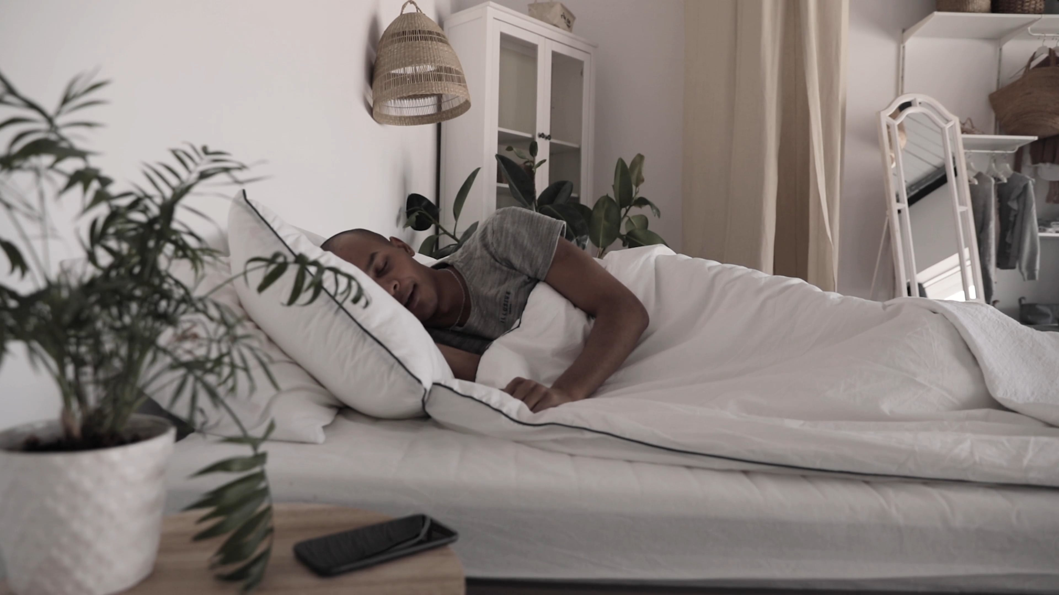
Holistic Productivity that's Authentically You
Health
Work
Habits
Notes:
Ping uses advanced sensor technology to combine your health data a

Slide 3
36 % of employed Americans (58 mil.) identify as independent workers
And that number will only continue to increase
Notes:
McKinsey's American Opportunity Survey

Slide 4
Post Covid-19 Work
58% Americans work from home once weekly
35 % work entirely from home
Work from home benefits
Increased satisfaction
Productivity
Health
Relationships
Notes:
Global consulting firm McKinsey & Company first stat

Slide 5
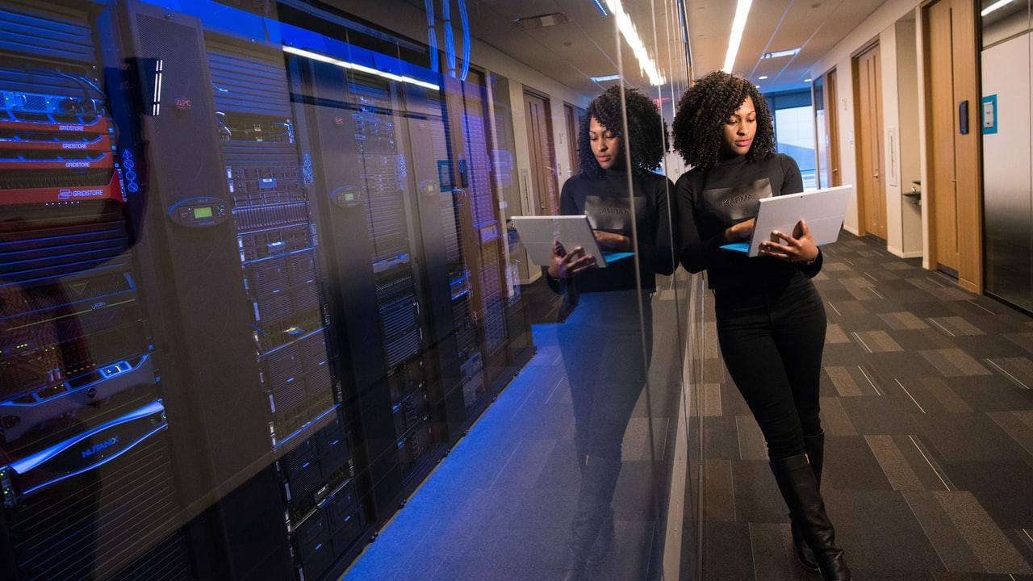
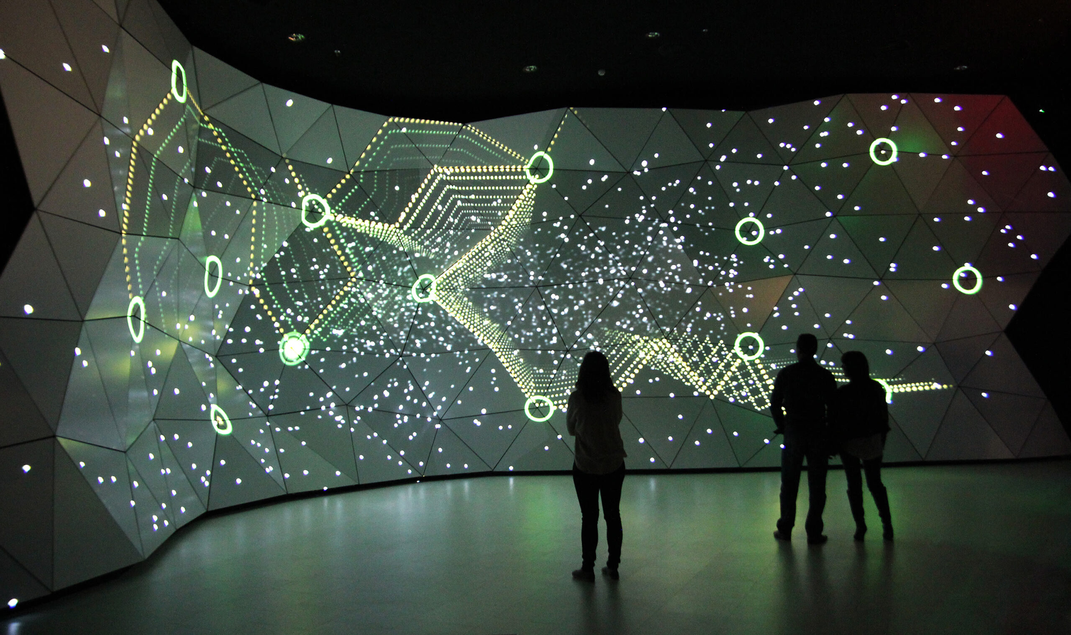
Opportunity for personal productivity has never been greater

Slide 6
What Is P1NG
Wearable Ring Tech
Laptop Extension
Ping App

Slide 7
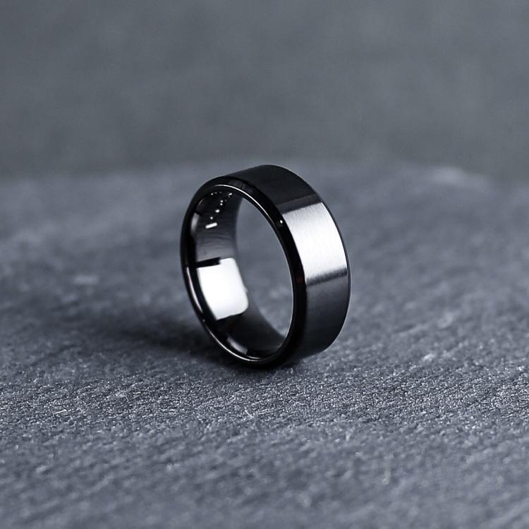
Productivity Ring
IOT sensors
Work interface
Hand writing and motor activities
Notes:
Global consulting firm McKinsey & Company first stat

Slide 8
Laptop Extension
User interface
Monitors mouse / Tabs
Creates data

Slide 9

P1NG Innovations App
Combines health and productivity
AI suggestions
Data

Slide 10
30-45 years old
Interested in wearable tech
Perfect P1NG
Consumer
Health oriented
Has lots of remote work (self-employed)

Slide 11

Behavioral and Psychographic
Behavorial
Works from home
Uses laptop or PC
Psychographic
Interested in self betterment
$$$ for productivity
Health conscious
Tech oriented

Slide 12
23.8 mil or 1/3 population
44 % Self Employed
40 Years Old
Millennials in US using wearable tech monthly
Millennials in US self employed
Average age of self employed in US

Slide 13
Business plan
The ads will promote our website and our product on amazon
03
Use multiple high traffic sites- IG, TIKTOK,YOUTUBE to run ads
01
02
We will sell on our website mainly as well as amazon

Slide 14

Pricing and Sales
One time purchase of ring
6 months P1NG Premium subscription
After 6 months, monthly subscription of 4.99$ for P1NG Premium
Ping app advertising
This Photo by Unknown author is licensed under CC BY.

Slide 15
Competitors
Potential Competitors
Slack
Manages productivity and working time for teams
Oura Ring
Health ring measuring health data and goals
Apple Watch
Watch/health tracker
P1NG Advantage
Health Data
Productivity Data

Slide 16
Thank you! Any Questions?

